Slide 1
MEDICAL IMAGE CLASSIFICATION USING CNN
Project Report
Developed using Python and TensorFlow
Presented By :
Madasu Harshini

Slide 2
Introduction
Medical Image Classification is a deep learning application that automatically classifies medical images into different categories.
In this project, chest X-ray images are classified as Normal or Pneumonia using a Convolutional Neural Network (CNN).

Slide 3
Problem Statement
Manual analysis of X-ray images by doctors takes time and may lead to delays in diagnosis.
The objective is to develop an automated system that can identify pneumonia from chest X-ray images quickly and accurately using deep learning techniques.

Slide 4
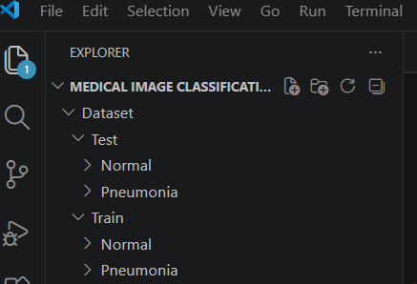
Dataset Description
The dataset contains chest X-ray images divided into:
Normal Images
Pneumonia Images
Dataset Structure :
The Chest X-Ray dataset is divided into Training and Testing folders. Each folder contains two classes:
Normal – Healthy lung X-ray images
Pneumonia – X-ray images affected by pneumonia

Slide 5
Tools and Technologies Used
Tool | Purpose
Python | Programming Language
TensorFlow | Deep Learning Framework
NumPy | Numerical Computation
VS Code | Development Environment
CNN | Image Classification Model

Slide 6
Project Architecture
Input X-Ray Image ↓ Image Preprocessing ↓ CNN Model ↓ Feature Extraction ↓ Classification ↓ Normal / Pneumonia

Slide 7
Training Process
Load training images.
Apply preprocessing.
Train CNN model.
Validate using test images.
Save trained model as model.h5.

Slide 8
CNN Model Architecture
Layers Used:
Convolution Layer (Conv2D)
Max Pooling Layer
Convolution Layer
Max Pooling Layer
Flatten Layer
Dense Layer
Output Layer
CNN automatically extracts important features from X-ray images.

Slide 9
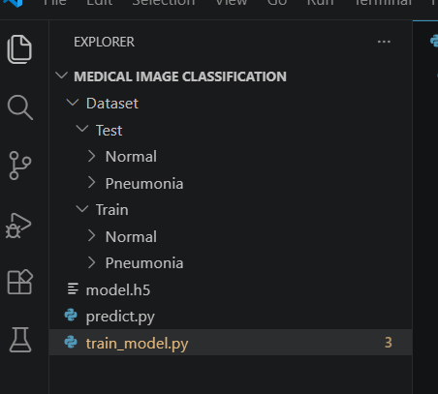
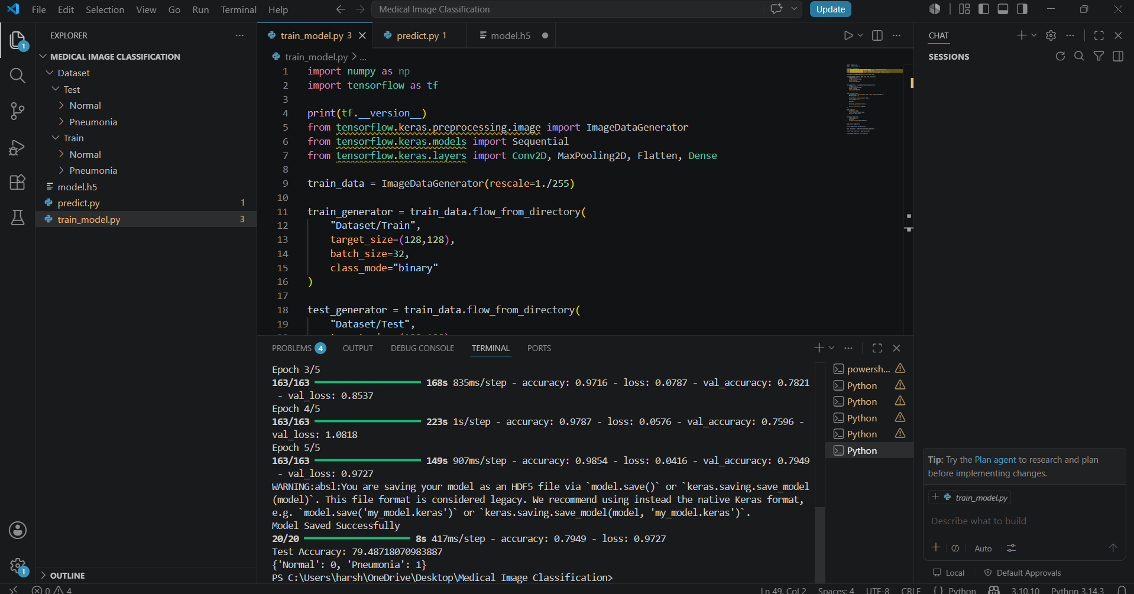
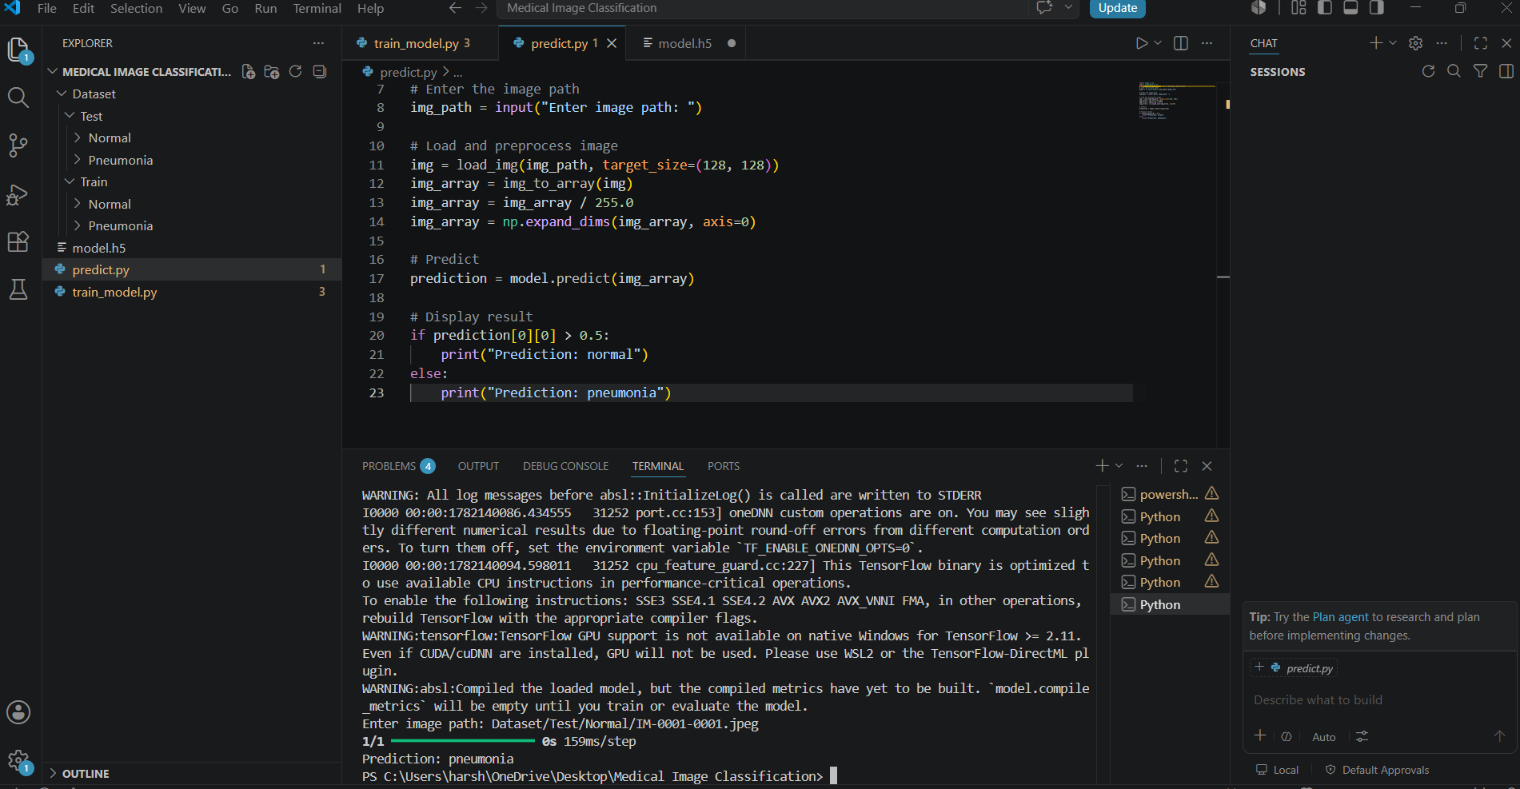
Results
Successfully classified chest X-ray images.
Generated trained model (model.h5).
Predicted Normal and Pneumonia cases.

Slide 10
Future Scope
Detect multiple diseases.
Improve model accuracy.
Deploy as a web application.
Integrate with hospital systems.
Real-time diagnosis support.

Slide 11
Conclusion
The Medical Image Classification system successfully uses a Convolutional Neural Network (CNN) to classify chest X-ray images into Normal and Pneumonia categories.
The project demonstrates the effectiveness of deep learning in healthcare and provides a foundation for intelligent medical diagnosis systems.

Slide 12


